Slide 1
Outline
Introduction
Statement of project problem
Scope & objective
Significant of the project
Use case diagram
User interface prototyping
Sequence diagram
Activity diagram
Class diagram
Persistent modeling
Deployment diagram

Slide 2
Background of the Study
In Haramaya University particularly Faculty of computing and Informatics there are so many final year projects which done every year.
Although final year projects are good and appreciable, there is no organized repository system for the project and it is difficult for junior students and also for instructors to identify whether the project is done or not before, there is copying of projects or plagiarism
Due to manual system there is wastage time, effort, money and failure in morality of the students who come up with similarity of the project

Slide 3
Cont.…
Having this problems in mind, we come up with a solution to design and implement a system that helps the students and instructor to identify previously done project and their constraints along with the scope of such projects.
The system is also going to be developed in order to enable students to upload their project and calculate the grade based on evaluation and examination made by examiner.
Finally, our project is going to reduce the time wastage, effort made by students and coordinator in a process of finding and identifying developed project and as well as problem related to plagiarism.

Slide 4
Statement of the Project Problem
The first and foremost problem of existing system is that, previously there is no organized mechanism to store developed projects.
Copying others project with small modification, which then result in plagiarism.
There were no organized mechanism that students communicate with their coordinator and Advisor.
The existing system lack efficiency and effectiveness to perform or operate its tasks.

Slide 5
Scope of the Project
The project is going to be developed for collage of computing and informatics.
Administrator should able to create its account and assign coordinator for each department.
Coordinators should be able to post notifications and submitted titles for students.
Students should be able to upload their documentation’s and implementation’s.
System Should enables advisors to control student’s project progress.

Slide 6
Objectives of the Project
General objective
The main objective of our project is to develop web based academic project management and evaluation system for collage of computing and informatics of Haramaya University.
Specific Objective
To gather Requirement on how existing system used to manage academic project management activity.
To design both user interface and database of the academic project management and evaluation system.

Slide 7
Cont.…
To analyze the requirement that has been gathered so far about working of existing system.
To model the proposed system to solve and reduce problems that has been seen on academic project management and evaluation system.
Finally, we used to test the developed system as a unit its individual component and as a system the whole package.

Slide 8
Significance of the Project
The new system is beneficial for both students and CCI.
For Students:
Reduce time and effort of finding undeveloped titles.
Make them self-dependent and self-confident by reducing plagiarism of project.
Organize the way students communicate with their advisor and coordinator.

Slide 9
Cont.….
For University:
Reduce improper resource wastage.
Reduce work overload of staff.
Reduce plagiarism of project.
Facilitate a way to identify between previously developed and undeveloped projects.
Enable organized repository of developed projects.
Facilitate hierarchical control and communication of advisor, examiner, coordinator and administrator

Slide 10
Use case modeling
A use case diagram in the Unified Modeling Language (UML) is a type of behavioral diagram defined by and created from a Use-case analysis.
Its purpose is to present a graphical overview of the functionality provided by a system in terms of actors, their goals (represented as use cases), and any dependencies between those use cases.

Slide 11
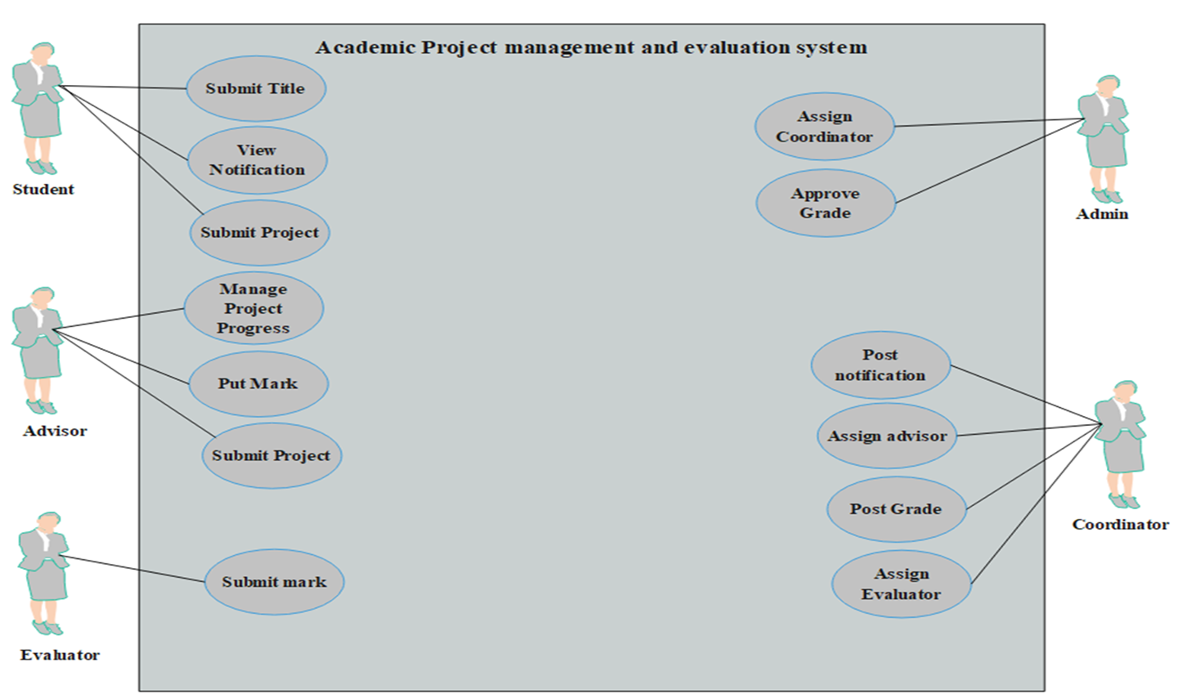
Figure 1: Essential Use case diagram

Slide 12
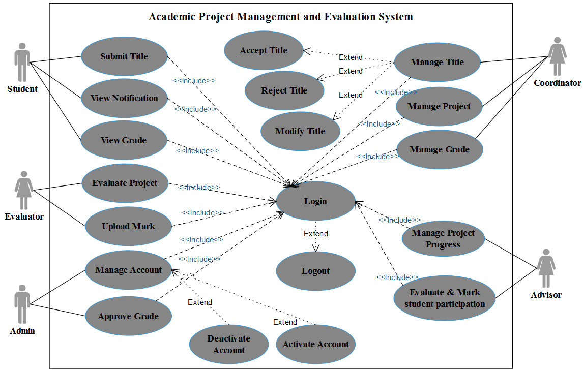
Figure 2: System Use Case Diagram

Slide 13
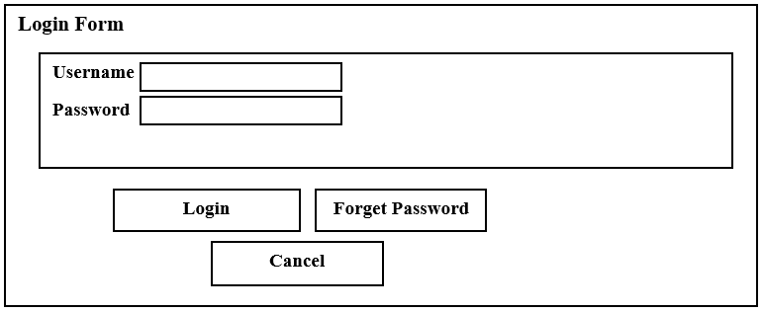
User Interface Prototyping
user interface prototype is an iterative analysis technique in which users are actively involved in the mocking-up of the UI for a system.
Figure 3: User Interface Diagram for Login to the system

Slide 14
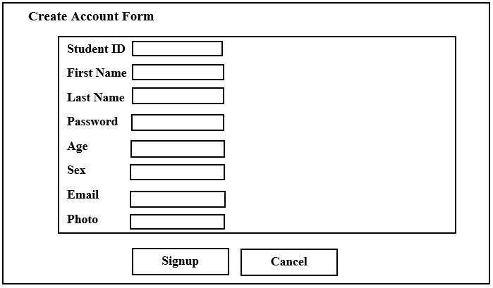
Figure 4:User Interface Diagram for Registering Student

Slide 15
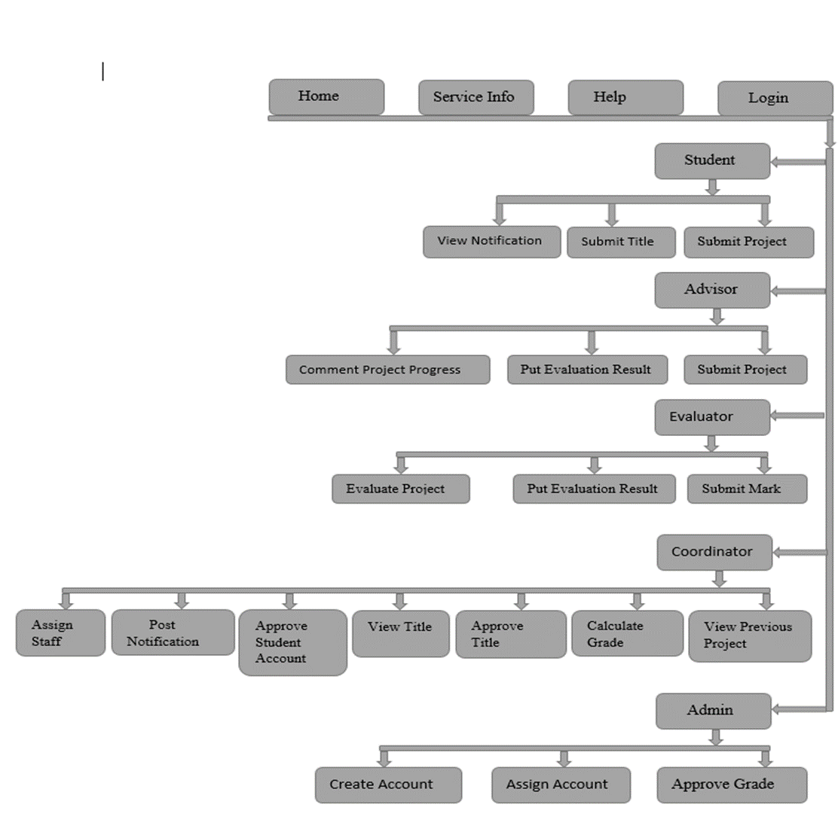
Figure 5: Proposed System Flowing Diagram

Slide 16
Sequence Diagram
UML sequence diagrams model the flow of logic within our system in a visual manner, enabling us both to document and validate our logic.
In fact they used to illustrate the sequence of action

Slide 17
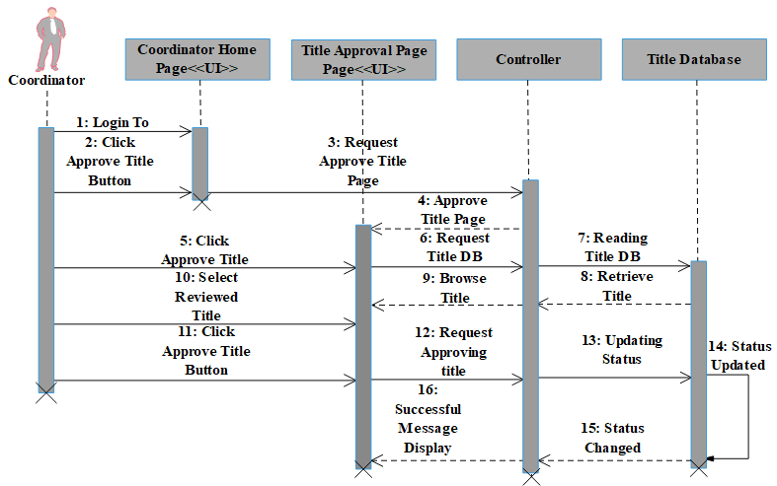
Figure 6: Sequence Diagram of Approving Title

Slide 18
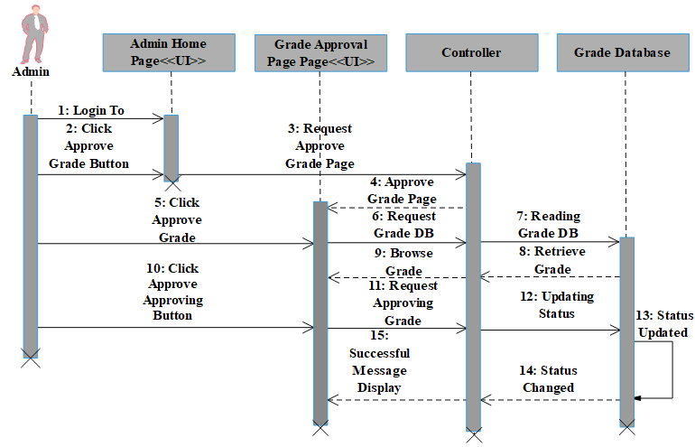
Figure 7: Sequence Diagram of Grade Approval

Slide 19
Activity Diagram
Activity diagram is another important behavioral diagram in UML diagram to describe dynamic aspects of the system.
Activity diagrams represent workflows in a graphical way. They can be used to describe the business workflow or the operational workflow of any component in a system.

Slide 20
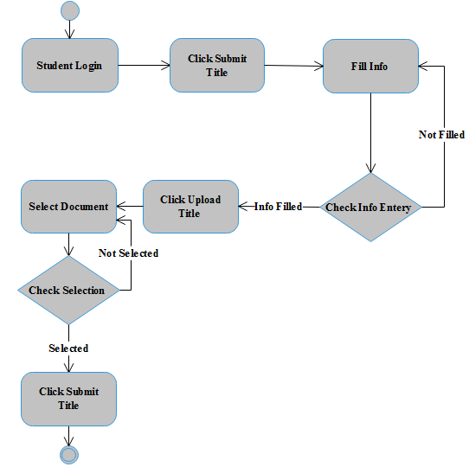
Figure 8: Activity Diagram for Submitting Title

Slide 21
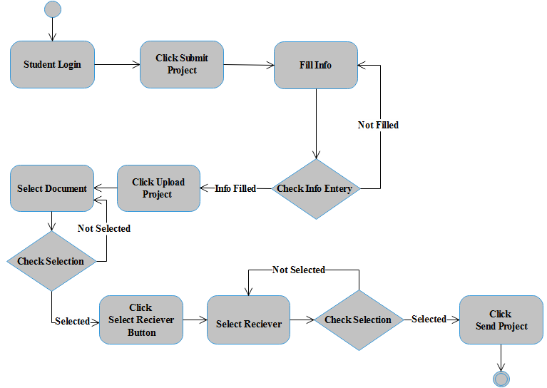
Figure 9: Activity Diagram for Sending Project

Slide 22
Class Diagram Modeling
The class diagram provides a static structure of all the classes that exist within the system. Classes are arranged in hierarchies sharing common structure and behavior and are associated with other classes.
It shows the classes in a system, attributes, and operations of each class and the relationship between each class.
In most modeling tools, a class has three parts. Name at the top, attributes in the middle and operations or methods at the bottom.

Slide 23
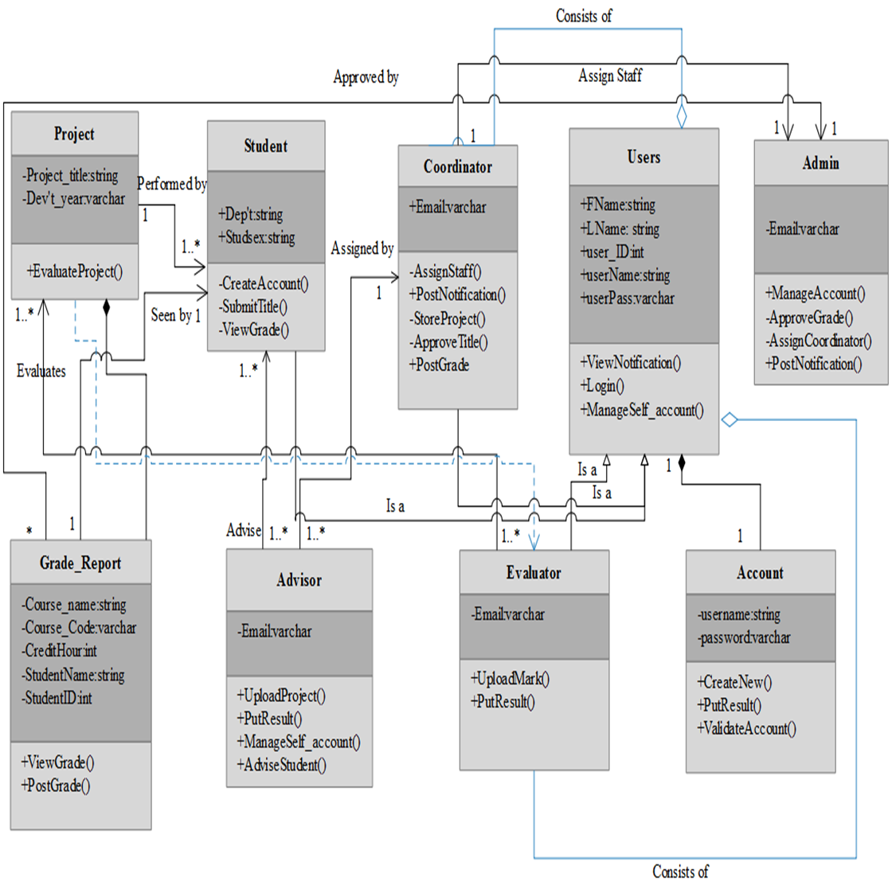
Figure10: Class Diagram showing APMES

Slide 24
Persistent Modeling/ Database Design
Database design is the process of producing a detailed data model of a database.
This logical data model contains all the needed logical and physical design choices and physical storage parameters needed to generate a design in a Data Definition Language, which can then be used to create a database.
A fully attributed data model contains detailed attributes for each entity

Slide 25
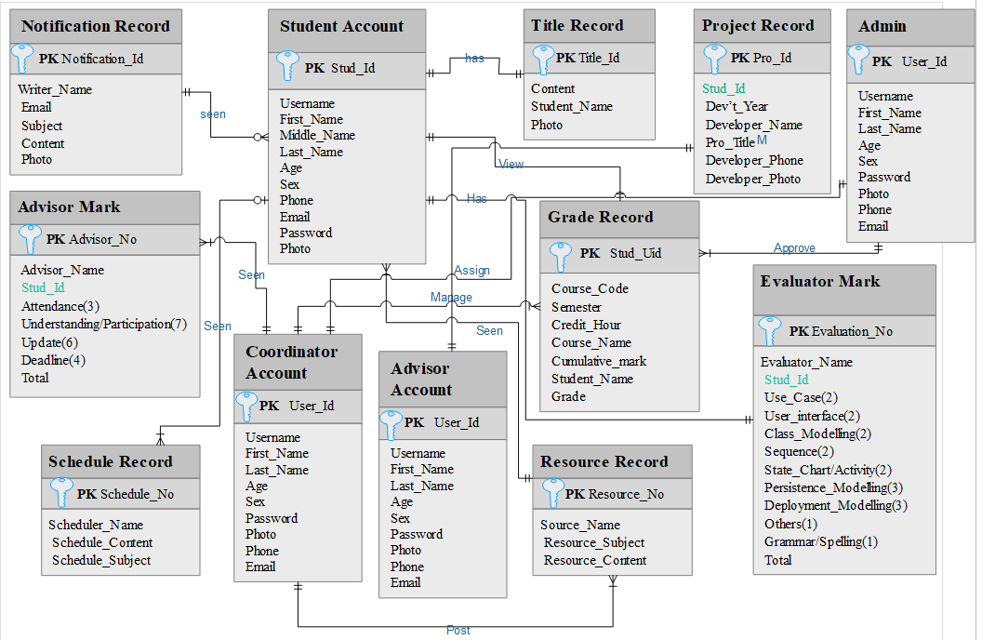
Figure 11: Persistence Database Diagram

Slide 26
Deployment Diagram
Deployment diagram depicts a static view of the run-time configuration of processing nodes and the components that run on those nodes.
In other words, deployment diagrams show the hardware for our system, the software installed on that hardware, and the middleware used to connect the disparate machines to one another.
Deployment diagrams are useful when your software solution is deployed across multiple machines with each having a unique configuration.

Slide 27
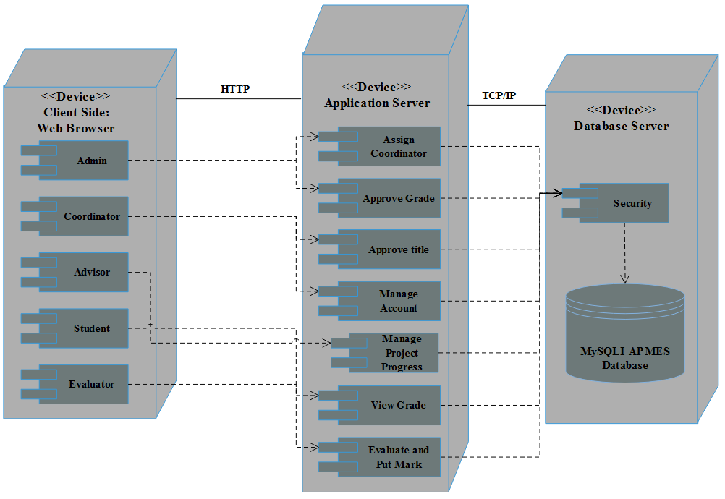
Figure 12: Deployment Diagram for APME

